Slide 1


“TALK”
Like A Leader
An Introduction to the
Language of Authentic Leadership
Created and facilitated by:
Ashley Allen-Brown, M.Ed., Ed.D.
Allen Brown Communications & Development, LLC
www.ashleyallenbrown.com

Slide 2

Learning Objectives
& Outcomes
Discover the language of leadership.
Understand what is behind the language of leadership.
Recognize that talk is only one element in accomplishing
  the goal of doing anything like a leader!
This course is a half to full day program complete with workbook created specifically for your organization.

Slide 3

The Language of Leadership

Slide 4

The Language of Leadership
#1 - Conveys Personal Accountability
Confidence
Competence
Engaging
Inspiring
Focused

Slide 5
“You can post leadership words on the walls; but, employees are more likely to go by
what they see in the halls.”
~ Peter Stark (2011)

Slide 6
Talk is just talk.

Slide 7
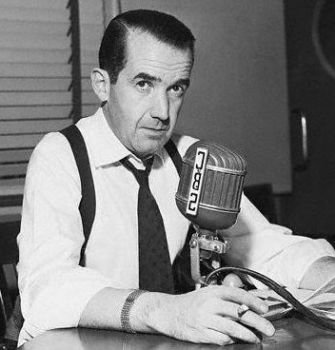
"To be persuasive, we must be believable;
to be believable, we must be credible;
to be credible, we must be truthful."
~ Edward R. Murrow

Slide 8

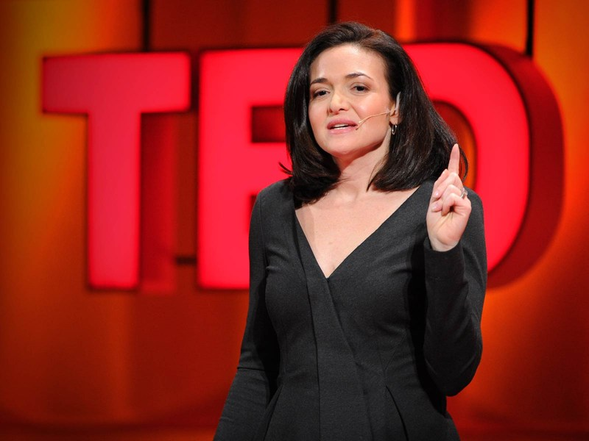

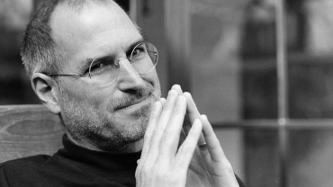

“Leadership language serves a specific purpose that is different from the language
used in a non-leadership role.”
- Brian Evje, Inc. (2013)

